Slide 1

Slide 1
Coursera Capstone Project
Coursera IBM Data Science Certification
Final Report By : Manish Kumar

Slide 2

Slide 10
Report Content
Introduction Content:
“Business Problem” to be solved for Interested one.
Data Section:
“Describe Data Requirement and Resources needed for problem solving.
Methodology Section:
(Main Content of Report”:))
1. Execute Data Processing
2. Expletory of Data Analysis 3. Inferential Statistical Testing 4. Machine Learning Used
02

Slide 3
Slide 10
Report Content
Result Section:
Discussing of result and finding of answer.
Discussion Section:
“Discussion of mentioned observation and recommendations.
Conclusion Section:
“Picking up answers and Conclusions”
03

Slide 4
Slide 10
Introduction
Scenario and Background
Problem to be resolved
Interested Audience
04

Slide 5
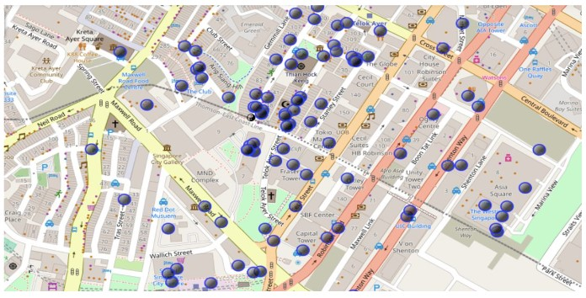
Slide 3
Execution & Results
Current residence Neighborhood in Singapore
M
3

Slide 6
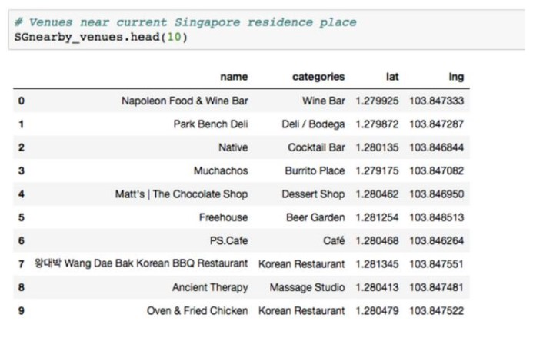
Slide 3
Execution & Results
Venue Around Neighbourhood in
M
3

Slide 7
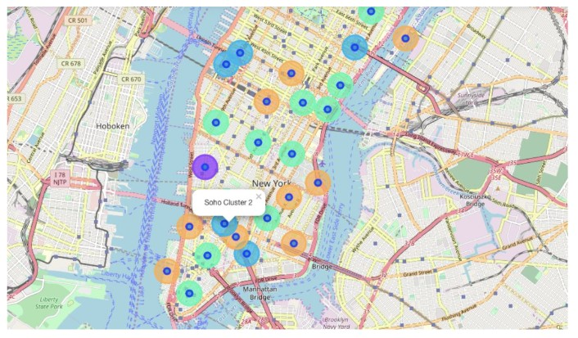
Slide 3
Execution & Results
Manhattan Map - Neighborhoods and Cluster of Venues
M
3

Slide 8
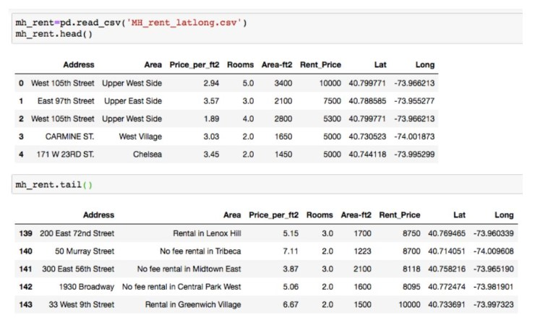
Slide 3
Execution & Results
Geodata Manhattan apts for rent
M
3

Slide 9
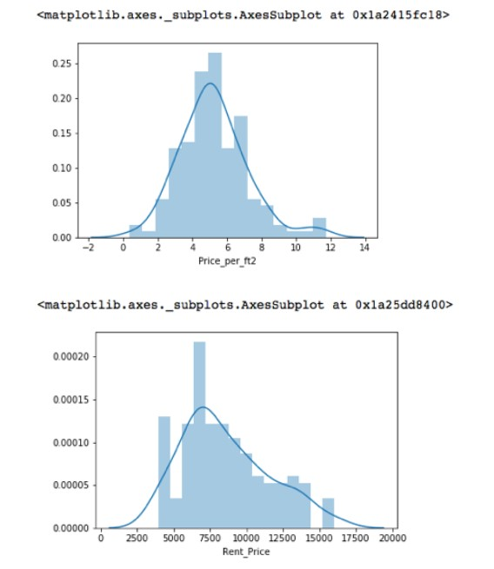
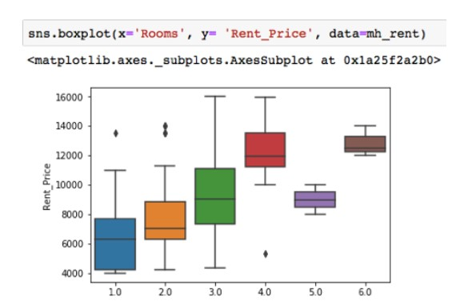
Slide 3
Execution & Results
Rental Price Statistics MH Apartments
M
3

Slide 10
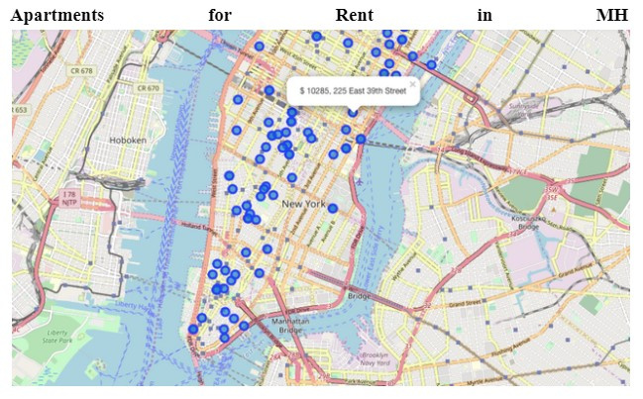
Slide 3
Execution & Results
MH apt for rent with venue clusters
M
3

Slide 11
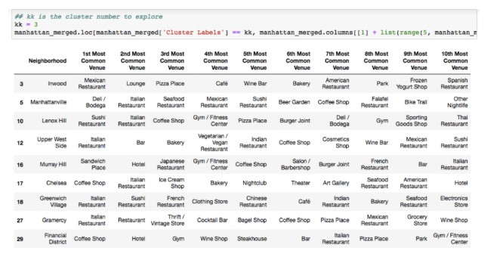
Slide 3
Execution & Results
Venues of cluster 3
M
3

Slide 12
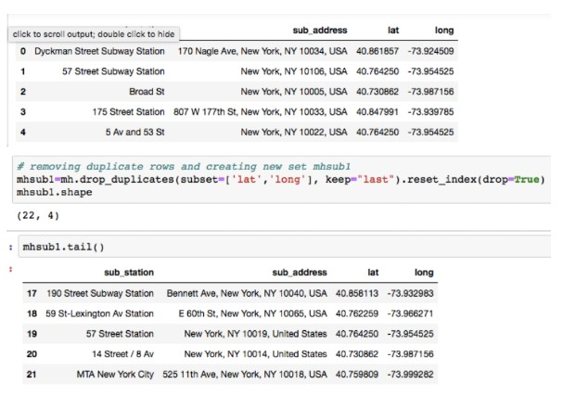
Slide 3
Execution & Results
Manhattan subway stations geodata
M
3

Slide 13
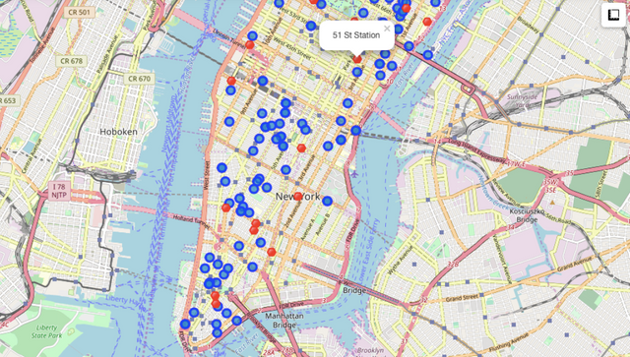
Slide 3
Execution & Results
Apts for rent (blue) and subway stations (red)
M
3

Slide 14
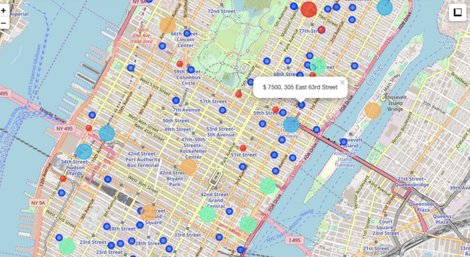
Slide 3
Selected Apartment!
The ONE consolidated map shows all information for decision: Apartments address, price, neighborhood, a cluster of venues, and subway station nearby. Blue dots=apts ,
Red dots=Subway station, Bubbles=Cluster of Venues
M
3

Slide 15
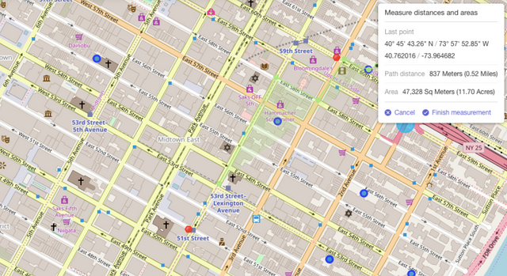
Slide 3
Selected Apartment!
Walk from home to work is less than 1 km
M
3

Slide 16
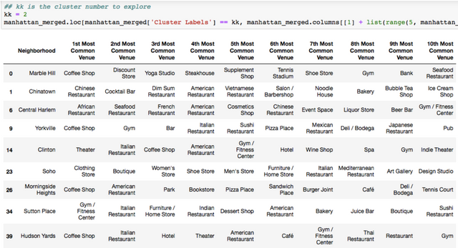
Slide 3
Selected Apartment!
Venus in Cluster 2 near future home
M
3

Slide 17
Slide 8
Conclusions
I feel rewarded with the efforts, time, and cash spent. I believe this course with all the topics lined is well worthy of appreciation.
This project has shown Pine Tree State an employment to resolve a real scenario that has impacting personal and money impact mistreatment knowledge Science tools.
The mapping with geological formation could be a terribly powerful technique to consolidate data and create the analysis and call thoroughly and confidently. I'd suggest for use in similar things.
One should keep up with recent tools for DS that continue to appear for application in many business fields.

Slide 18

Slide 11
THANK YOU

